Slide 1


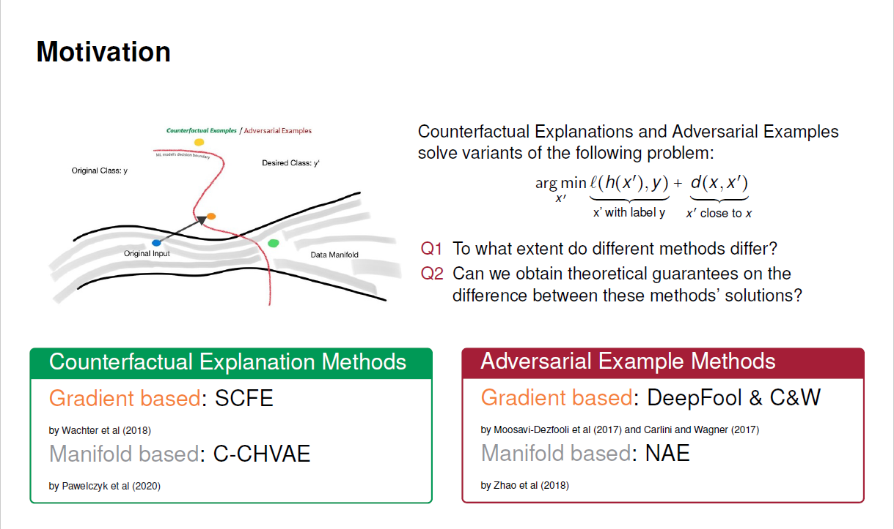
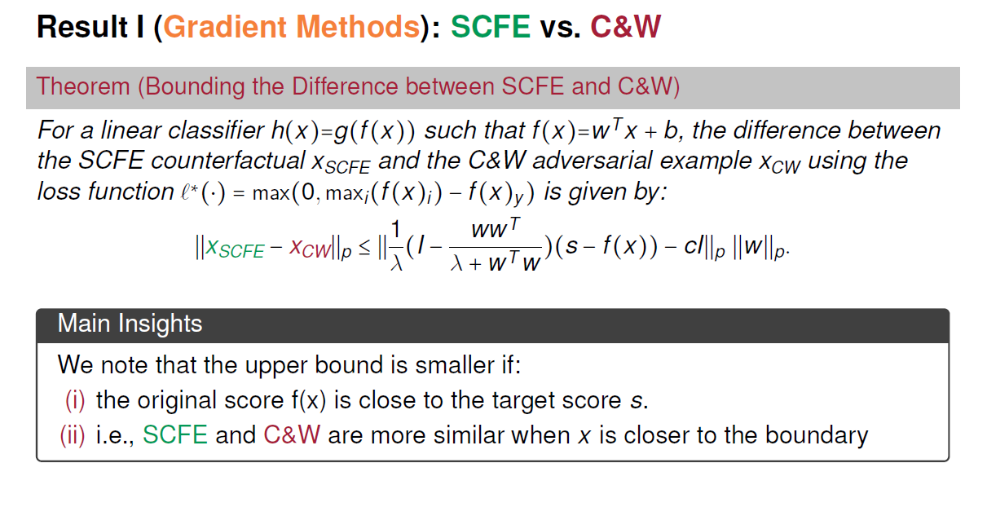
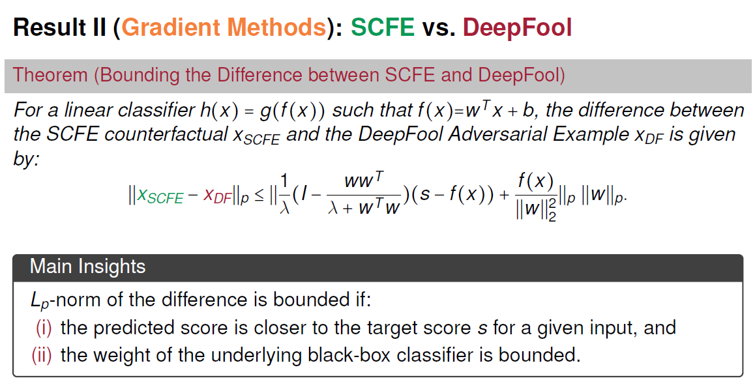
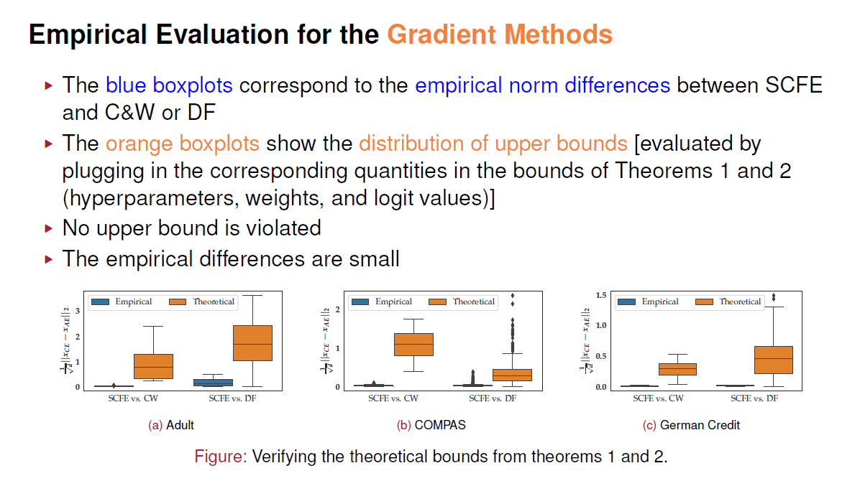
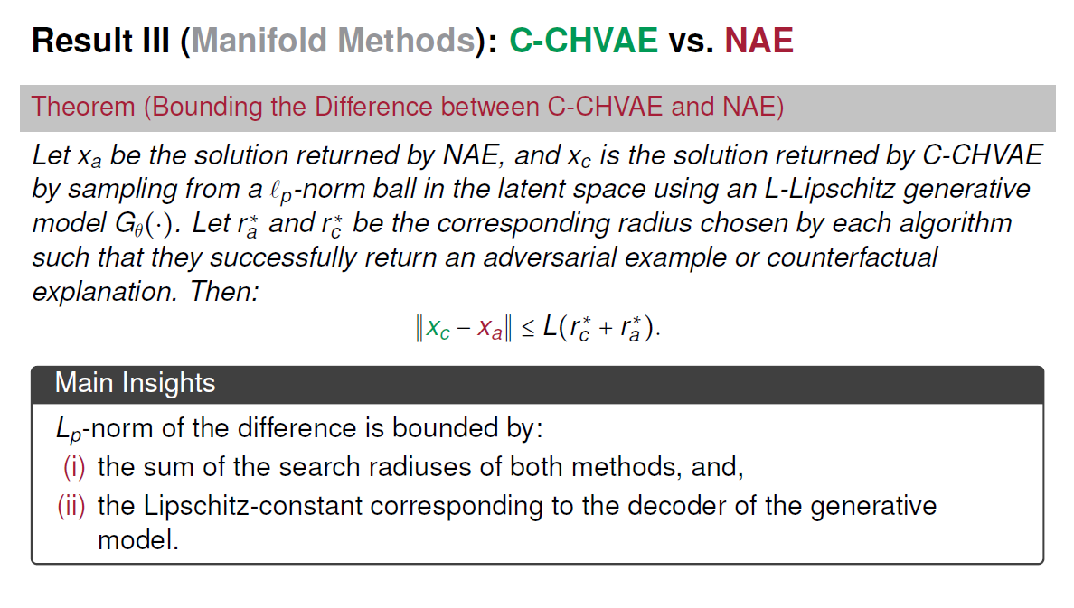
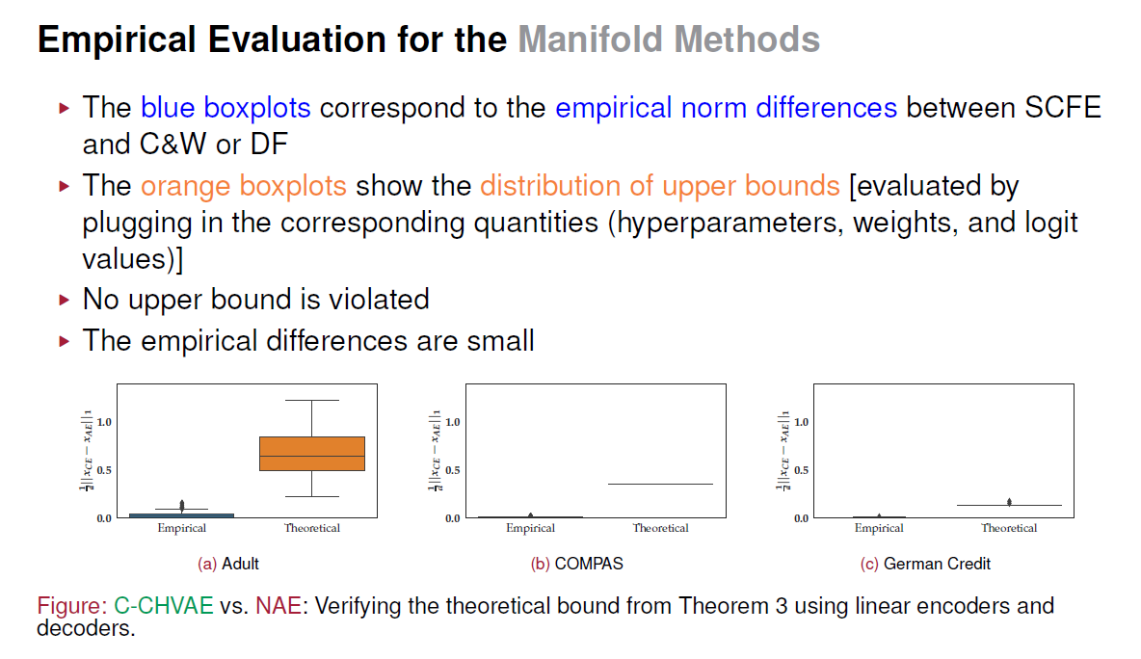
On the Connections between Counterfactual Explanations and Adversarial Examples Martin Pawelczyk (University of Tübingen), Shalmali Joshi, Chirag Agarwal, Sohini Upadhyay, Himabindu Lakkaraju (Harvard University)
Arxiv:2106.09992; On the Connections between Counterfactual Explanations and Adversarial Examples; Pawelczyk et al (2021)
Summary: For gradient based methods and manifold based methods, we can bound the difference between counterfactual explanations and adversarial examples. The empirical norm differences are usually extremely small.

